Slide 1
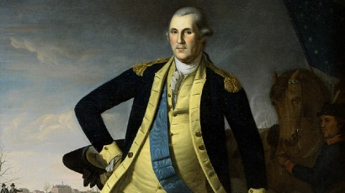
Periods 1-3 Review

Slide 2
Period 1 (1491-1607)
Differences between Native American groups
Impact of the Columbian Exchange (both on America and Europe)
Key Content Knowledge
Columbian Exchange
Joint-stock companies
encomienda

Slide 3
Period 2 (1607-1754)
Different approaches of Spain, France, England
Differences between the colonies (NE/Ches, Middle Colonies)
British political, social, cultural, and economic exchanges with Great Britain.
Both stronger bonds with Britain and resistance to British control.

Slide 4
Key Content Knowledge
Puritans
Salutary neglect
Atlantic economy
King Philip’s War
Pueblo Revolt
Great Awakening (Protestant Evangelism)
Enlightenment
Atlantic slave trade
Chattel slavery

Slide 5
Period 3 ( 1754-1800)
British attempts to assert tighter control
American resolve to pursue self-government
Democratic and republican ideals
Migration within N. America and competition intensified conflicts
Key Content Knowledge
French/Indian War
Taxation without representation
Enlightenment (talent over hereditary privilege)
Thomas Paine – Common Sense
Declaration of Independence
Republican Motherhood

Slide 6
Articles of Confederation
Northwest Ordinance of 1787
Constitutional Convention (compromises, federalism)
Federalist vs. Anti-Federalists
Federalists vs. Democratic-Republicans
War between France and England challenges American neutrality
George Washington’s Farewell Address

