Slide 1
The End of Period 9

Slide 2
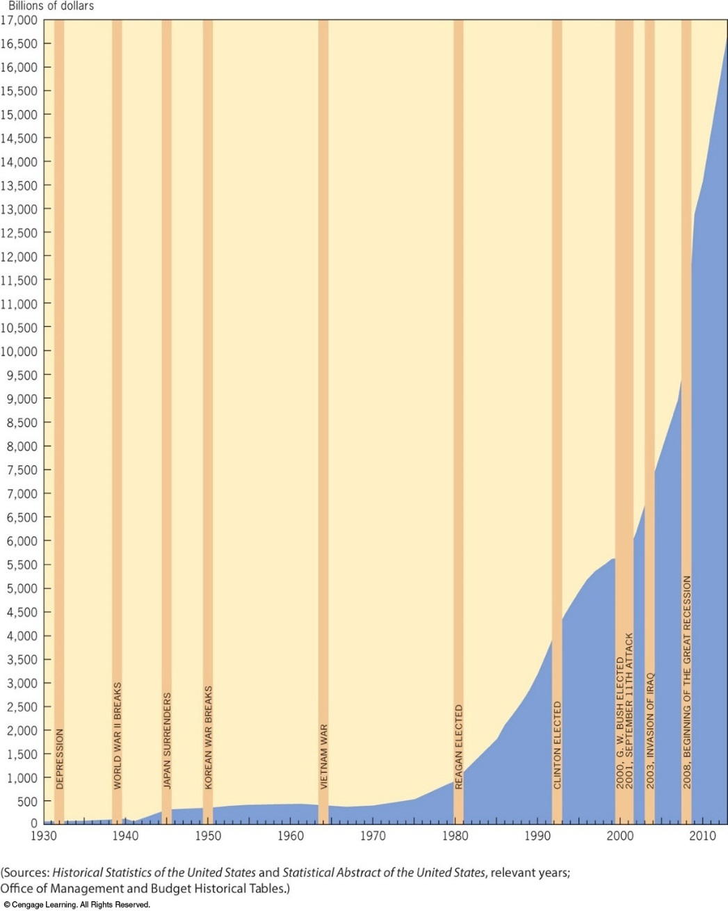

Slide 3
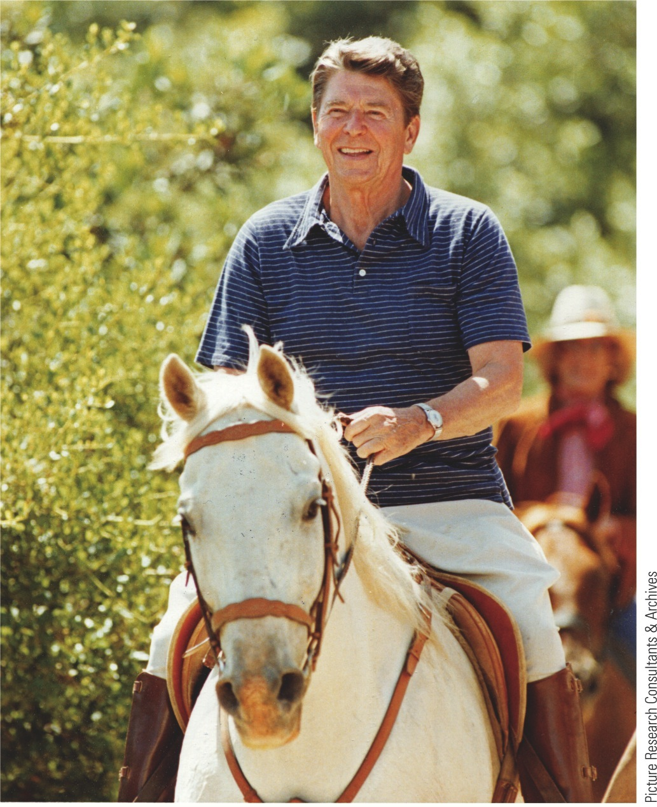
p934
Notes:
President Ronald Reagan Older than any man previously
elected to the presidency, Reagan displayed youthful
vigor both on the campaign trail and in office.

Slide 4
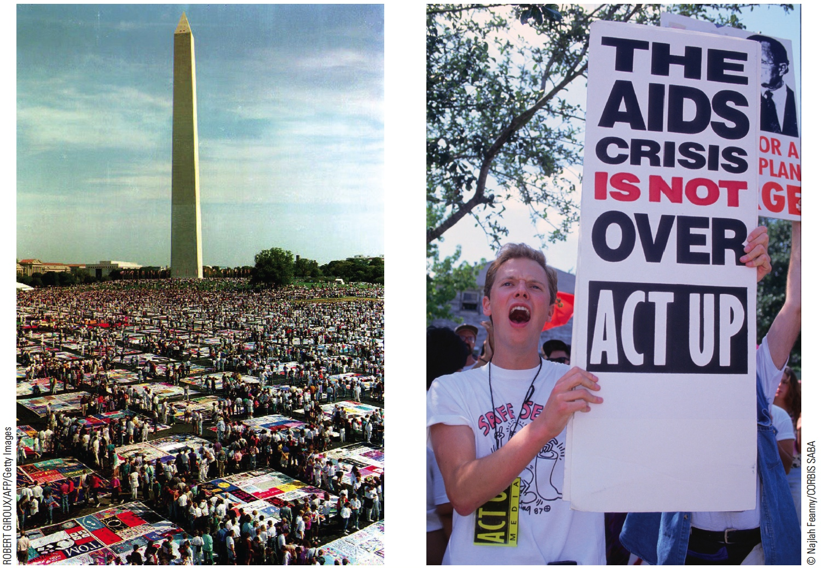
p944
Notes:
The Age of AIDS T he first diagnoses of the deadly acquired immunodeficiency syndrome (AIDS) were
made in 1981, and the disease spread at a horrifying pace. Concentrated disproportionately among homosexual
men, AIDS reached epidemic proportions within just a few years while eluding scientists’ hunt for a
treatment or cure. By 1988, nearly 83,000 cases had been reported in the United States alone. Sufferers of
the so-called “gay plague” faced stigma and discrimination from many fellow Americans, while critics
charged that the Reagan administration was slow to respond adequately to the epidemic. But the disease
also served as a galvanizing cause around which gay rights activists mobilized. The year 1987 saw the
beginning of the construction of a mammoth AIDS Memorial Quilt dedicated to the memory of the
disease’s victims, displayed here (left) at the National Mall in 1992 on its journey around the country. One
of the leading political activist organizations to emerge out of the epidemic was the AIDS Coalition to
Unleash Power (ACT UP), shown here (right) protesting at the 1992 Republican National Convention.

Slide 5
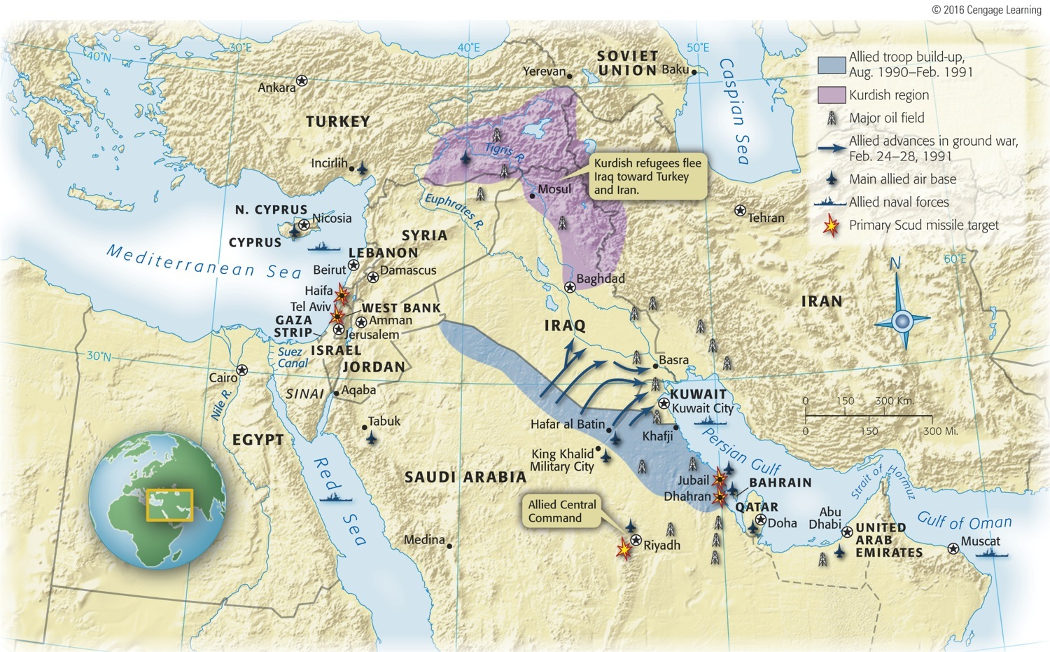

Slide 6
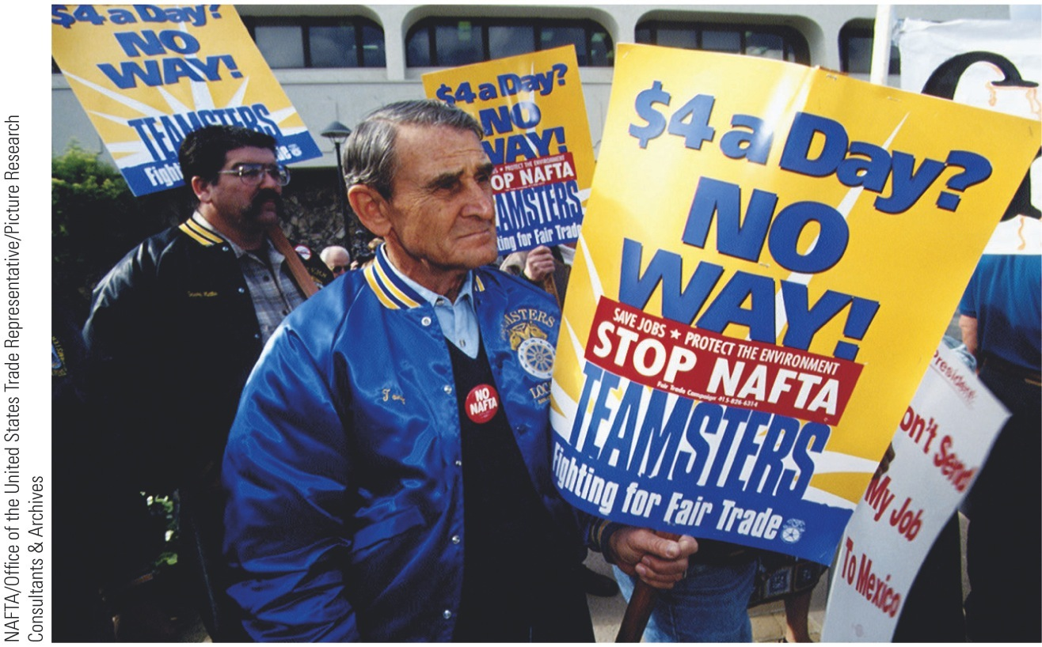
p967
Notes:
Protesting NAFTA, 1993 These members of the Teamsters Union feared that the adop-tion of the North American Free Trade Agree-ment would mean the replacement of high-paying American jobs with low-wage, nonunion Mexican labor. More than a decade later, the treaty still rankled. Policymakers disagreed about whether NAFTA had been damaging to American workers. In the 2008 election, the Republicans endorsed it, while the Democrats attacked it.

Slide 7
p968
Notes:
Outsourcing Jobs to India Sophisticated computer technology has allowed developing countries like India to attract Western employers seeking lower labor costs. India’s educated and English-speaking work force has made it particularly suitable for international call centers and computer programming.

Slide 8
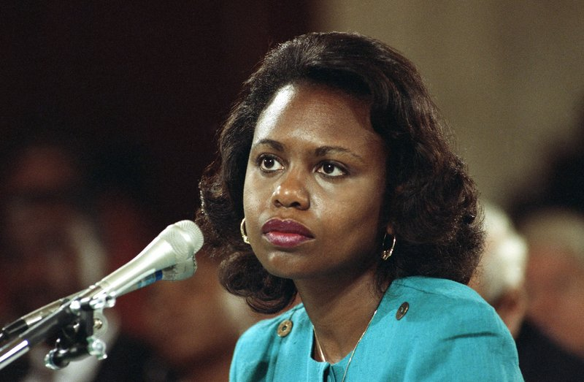

Slide 9
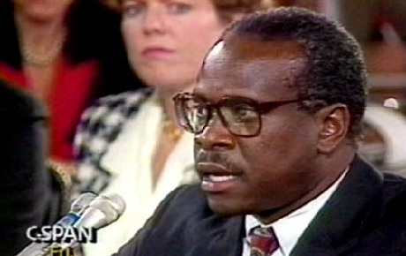

Slide 10
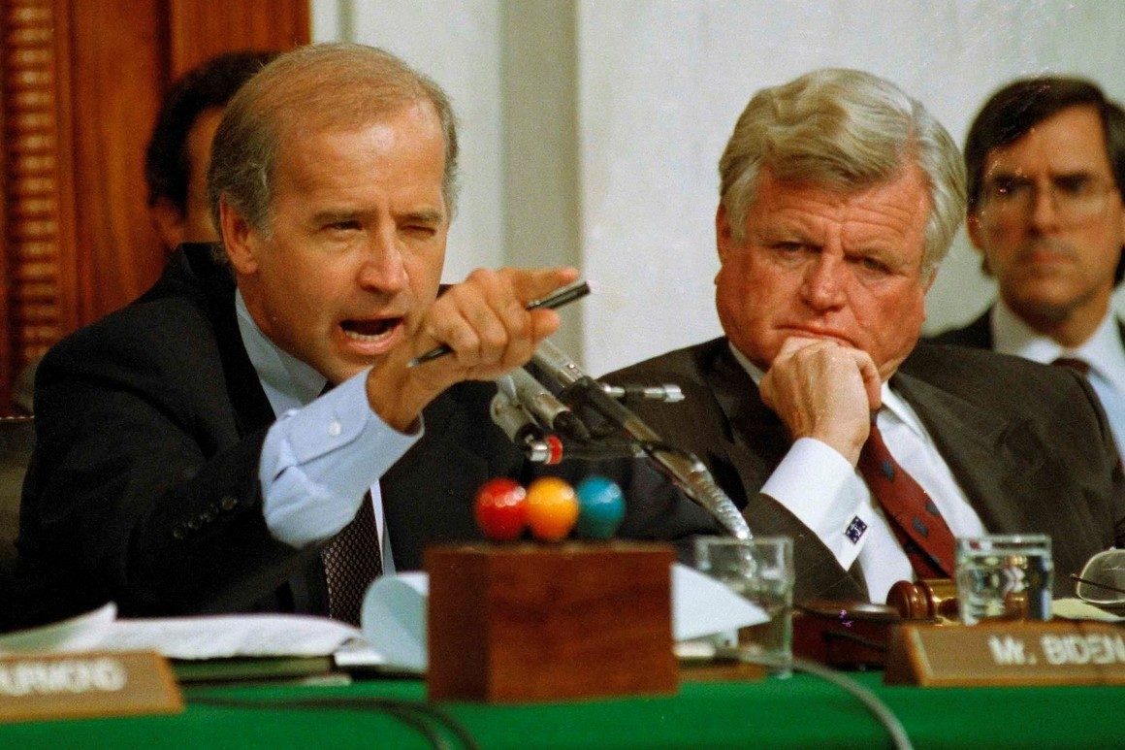

Slide 11
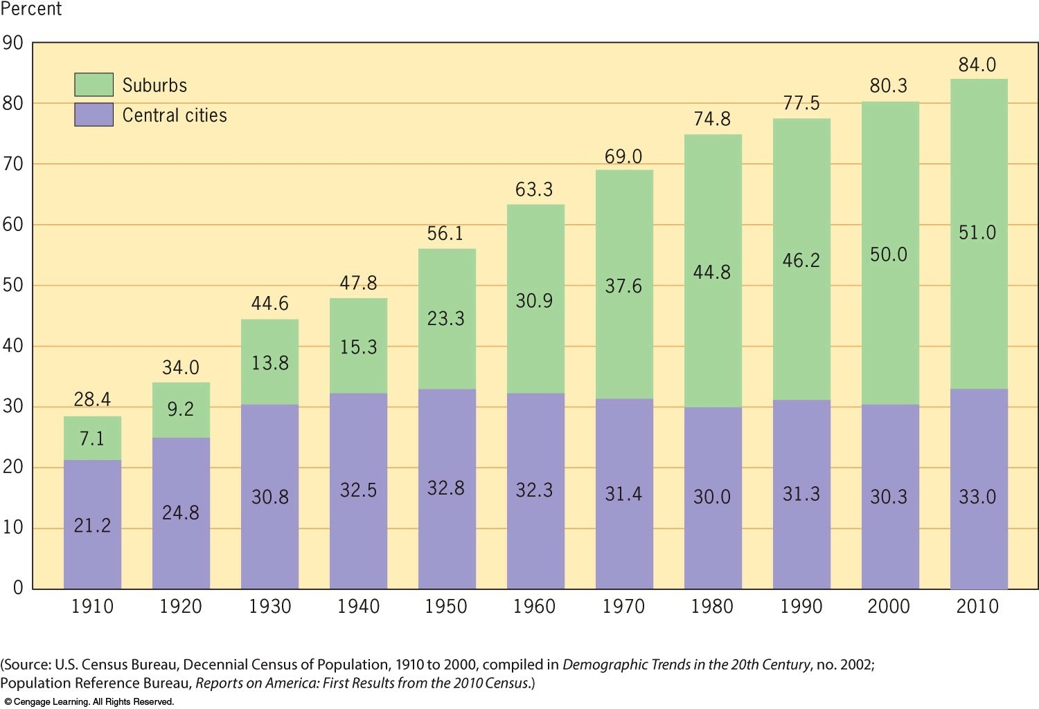
Figure 40-3 p965
Notes:
FIGURE 40.3 Percent of Total Population Living in Metropolitan Areas and in Their Central Cities and Suburbs, 1910–2010 © 2016 Cengage Learning
(Source: U.S. Census Bureau, Decennial Census of Population, 1910 to 2000, compiled in Demographic Trends in the 20th Century, no. 2002; Population Reference Bureau, Reports on America: First Results from the 2010 Census.)

Slide 13
Election of 2000 – Florida Results
Final certified results
Presidential candidate and running mate | Vote total | Party
George Walker Bush– Richard Bruce Cheney | 2,912,790 | Republican
Albert Arnold Gore Jr.– Joseph Isadore Lieberman | 2,912,253 | Democratic
Ralph Nader– Winona LaDuke | 97,488 | Green
Patrick Joseph Buchanan– Ezola Broussard Foster | 17,484 | Reform

Slide 18
The Impact of 9/11

Slide 19
I. The War on Terror Begins
In the fall of 2001, the United States sent troops to Afghanistan.
Al Qaeda had training bases in the country.

Slide 20
II. The U.S. Invades Iraq
The attacks of 9/11 led neoconservatives to call for a more aggressive U.S. foreign policy.
U.S. intelligence indicated that Iraq was developing Weapons of Mass Destruction (WMD)
The U.S. invaded Iraq.
They did not have WMDs.

Slide 21
III. The War on Terror at Home
The Department of Homeland Security was created.
It is meant to deter and prevent terrorist attacks.
The Patriot Act was passed.
It loosened many restrictions on intelligence gathering by U.S. security and government agencies.

Slide 22
The End of New Stuff
9.3 D
Despite economic and foreign policy challenges, the United States continued as the world’s leading superpower in the 21st century.

