Slide 1
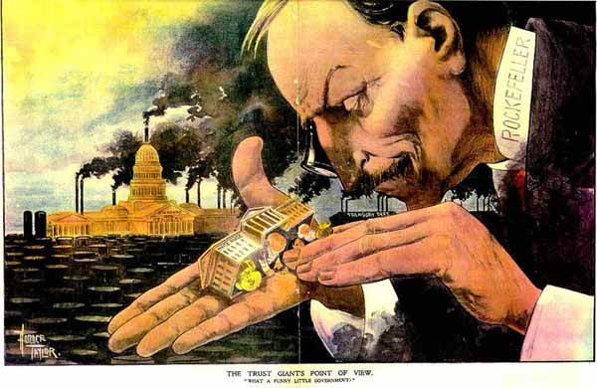
The Gilded Age (1875-1900)

Slide 2
Type 1 Writing
What are the strengths and weaknesses of the American political system at the federal level today? (2 minutes)
Discussion

Slide 3
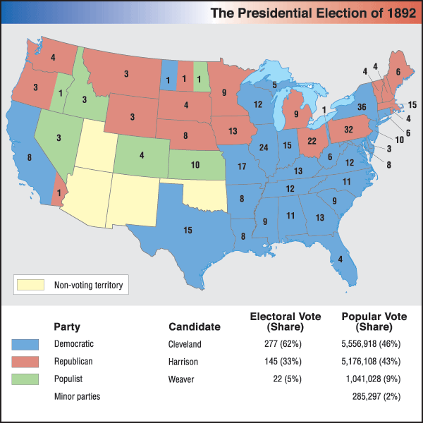
I. Political Life
Most Americans were deeply involved in political activity.
Mostly white males.
Democrats –
Republicans –
More corruption than during previous eras.

Slide 4
II. Congress Takes Charge
1870s – Congress exerted greater power than the executive.
McKinley Tariff Act – raised tariffs higher than ever before
Sherman Antitrust Act – initially weak, first attempt to regulate business combinations.

Slide 5
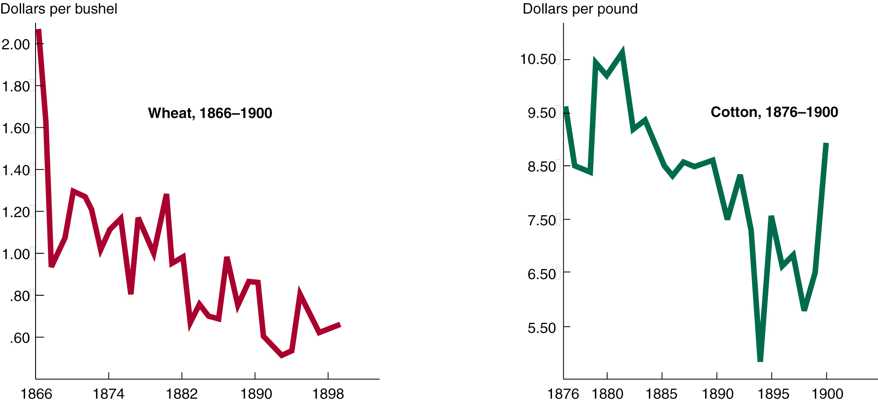
Falling Commodity Prices

Slide 6
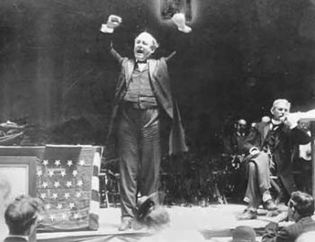
III. The Populist Movement
Farmer’s Complaints –
Farmer’s Alliance was the first attempt to organize.
Many wanted an alternative party.
Populists could win elections, but not power.

Slide 7
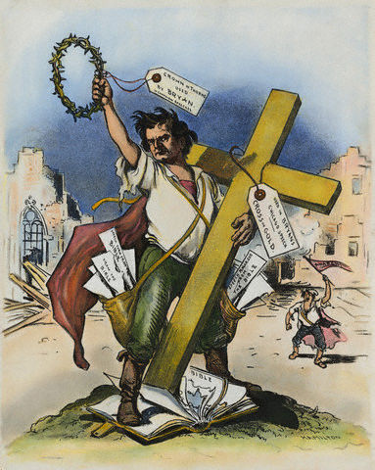
IV. The Silver Issue
The 1890s were a decade of economic crisis.
Quantity Theory of Money –
Silver became a social movement.
William Jennings Bryan’s “Cross of Gold Speech”

Slide 8
“Having behind us the producing masses of this nation and the world…we will answer their demand for a gold standard by saying to them: ‘ You shall not press down upon the brow of labor this crown of thorns, you shall not crucify mankind on a cross of gold.”

