Slide 1
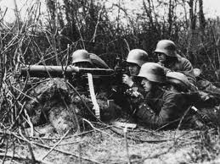
World War I

Slide 2
Learning Objectives
Students will analyze the factors that led to the outbreak of war in Europe.
Students will analyze the factors that led to U.S. involvement in World War I.
Students will analyze how the war impacted the U.S. home front.

Slide 3
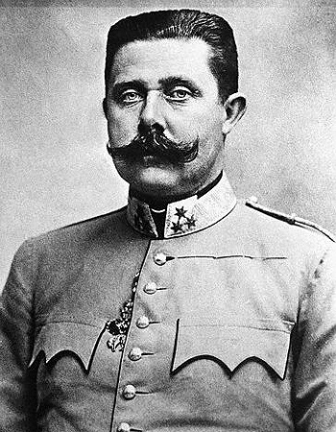
I. Causes
Nationalism
Imperialism
Alliance System
Assassination of Archduke Franz Ferdinand by Bosnian nationalists

Slide 4
Allied Powers vs. Central Powers
France
Russia
Great Britain
Germany
Austria-Hungary
Italy

Slide 5

II. American Response
Wilson proclaimed neutrality.
The U.S. hoped to trade with both sides.
By 1916, trade with the Central Powers was near zero.
Trade with the Allied powers had increased 400%

Slide 6
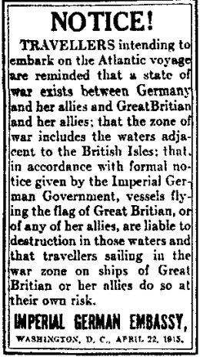
III. Increasing American Support for the War
Impact of German U-Boats –
Sinking of the Lusitania-British passenger ship, 128 Americans died.
The ship was also carrying weapons.

Slide 7
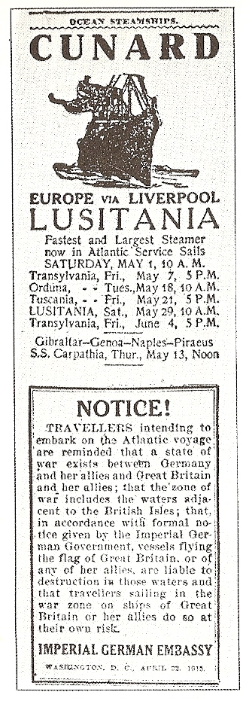

Slide 8
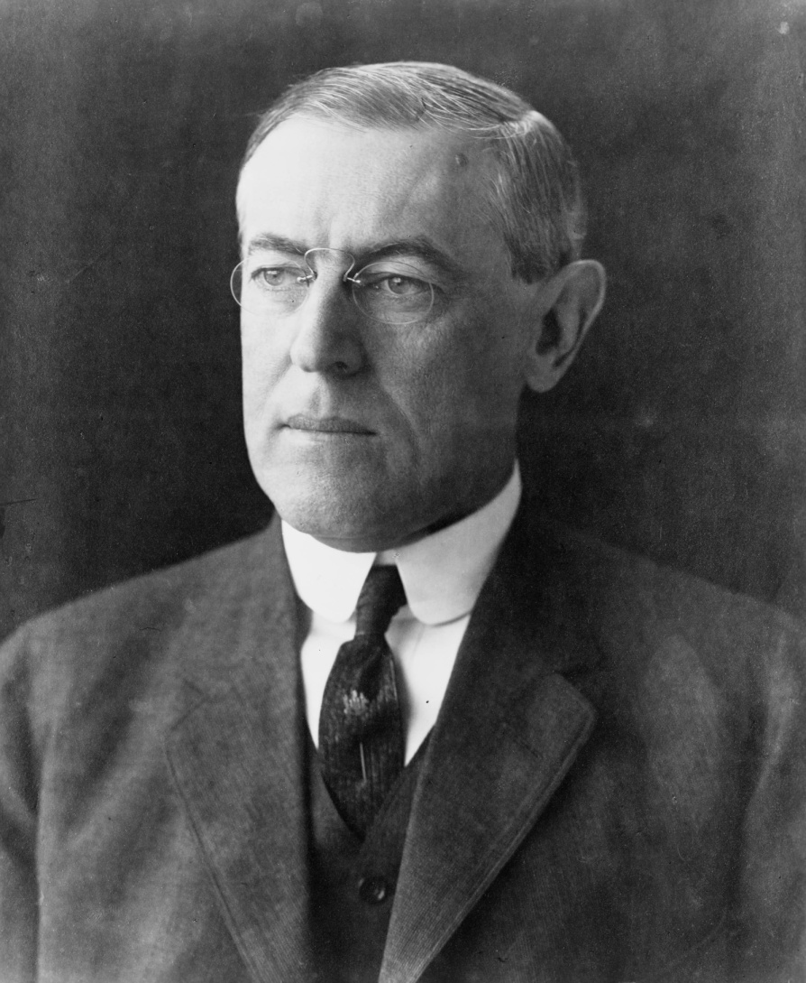
IV. America Moves Towards War
Jan. 31, 1917, Germany announcement –
February 3 – Wilson broke off diplomatic relations
Zimmerman Telegram –
After more American ships were sunk, Wilson declared war.

Slide 9
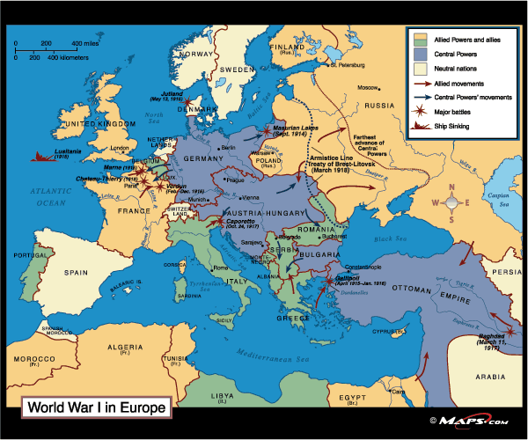

Slide 10
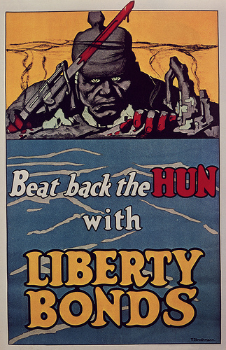
V. The Home Front During WWI
Americans were encouraged to buy Liberty Bonds
The government began to regulate food consumption.
The Espionage Act (1917) –
The Sedition Act (1918)

Slide 11
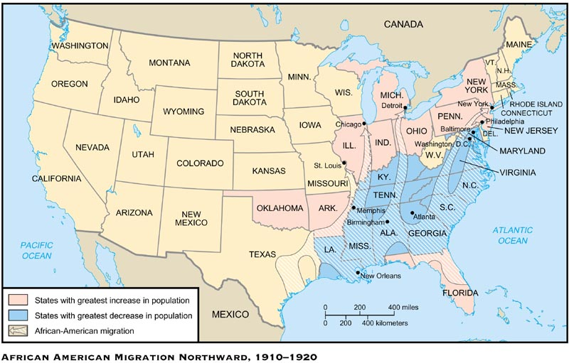
Opportunities for African Americans
During the Great Migration, nearly 600,000 African Americans moved North

